Slide 1
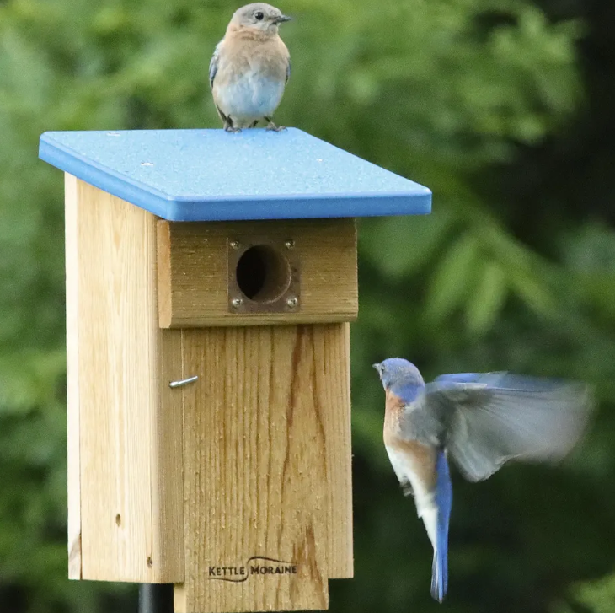
Building a Bluebird Nesting Box Workshop
Date & Time: Wednesday, February 18th 1-4
Location: Julie’s garage, 2902 Captain Sams Road
Who can come? Any garden club member
Max 12 participants
Cost: $20.00, does not include a pole for mounting
This cheerful, easy‑to-assemble kit comes with everything you need to create a cozy little bird bungalow—right down to a shiny copper guard that keeps sneaky predators at bay. Bring a screwdriver, roll up your sleeves, and add a dash of elbow grease. The bluebirds will be thrilled with their new real estate.
https://www.signupgenius.com/go/9040E4BA4AD2AA7FF2-62067787-build

